Slide 1
第六讲 ParFlow中Solid文件的构建
杨晨 中山大学大气科学学院

Slide 2
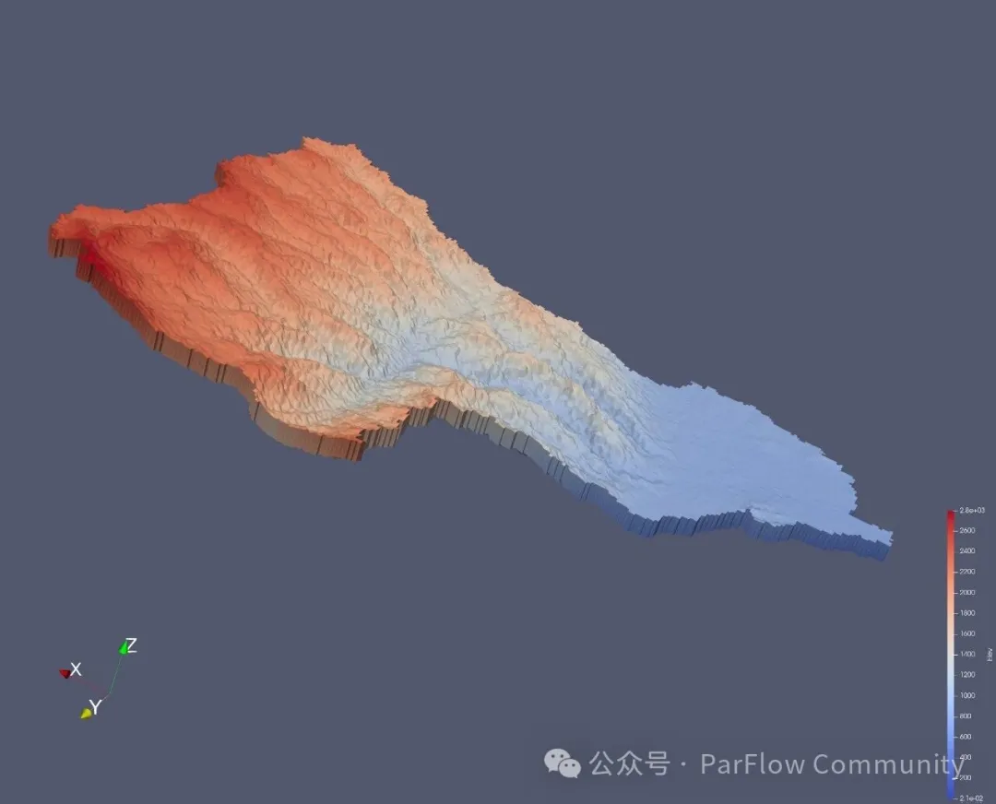
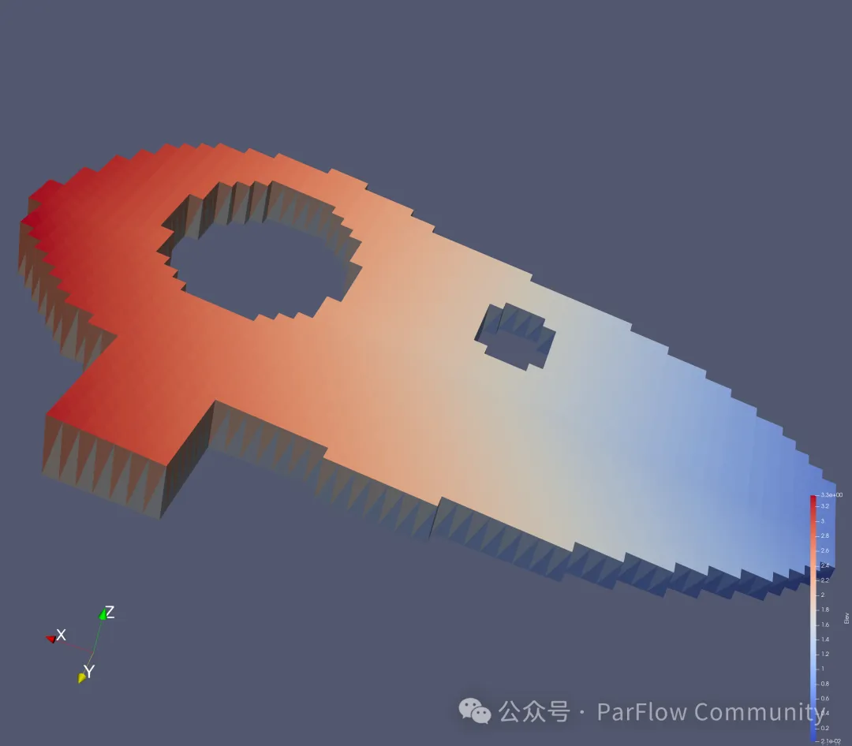

Slide 3
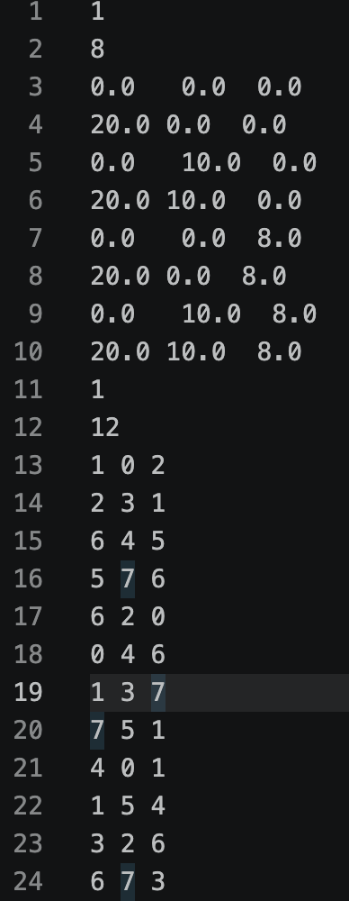
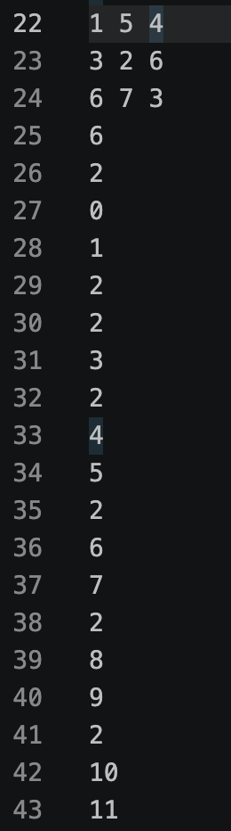
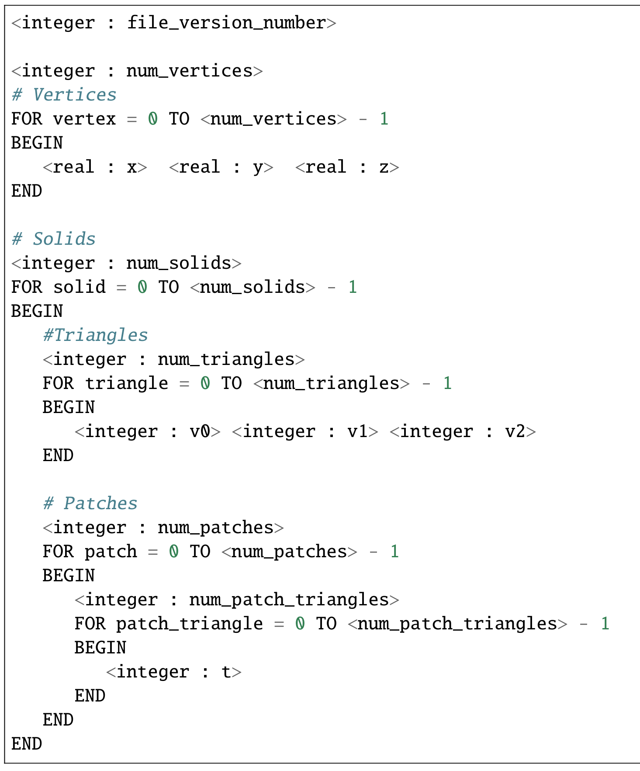
1. pfsol文件格式
file_version
num_vertices
num_patches
num_patch_triangles
num_patch_triangles
num_solids
num_triangles
num_patch_triangles
num_patch_triangles
num_patch_triangles
num_patch_triangles
ParFlow manual

Slide 4
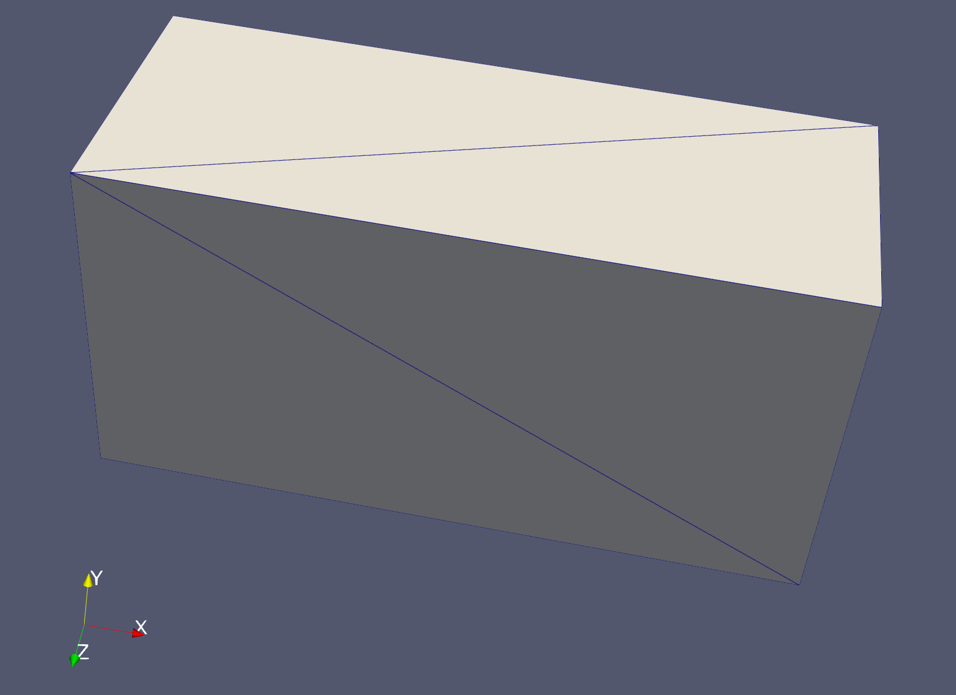
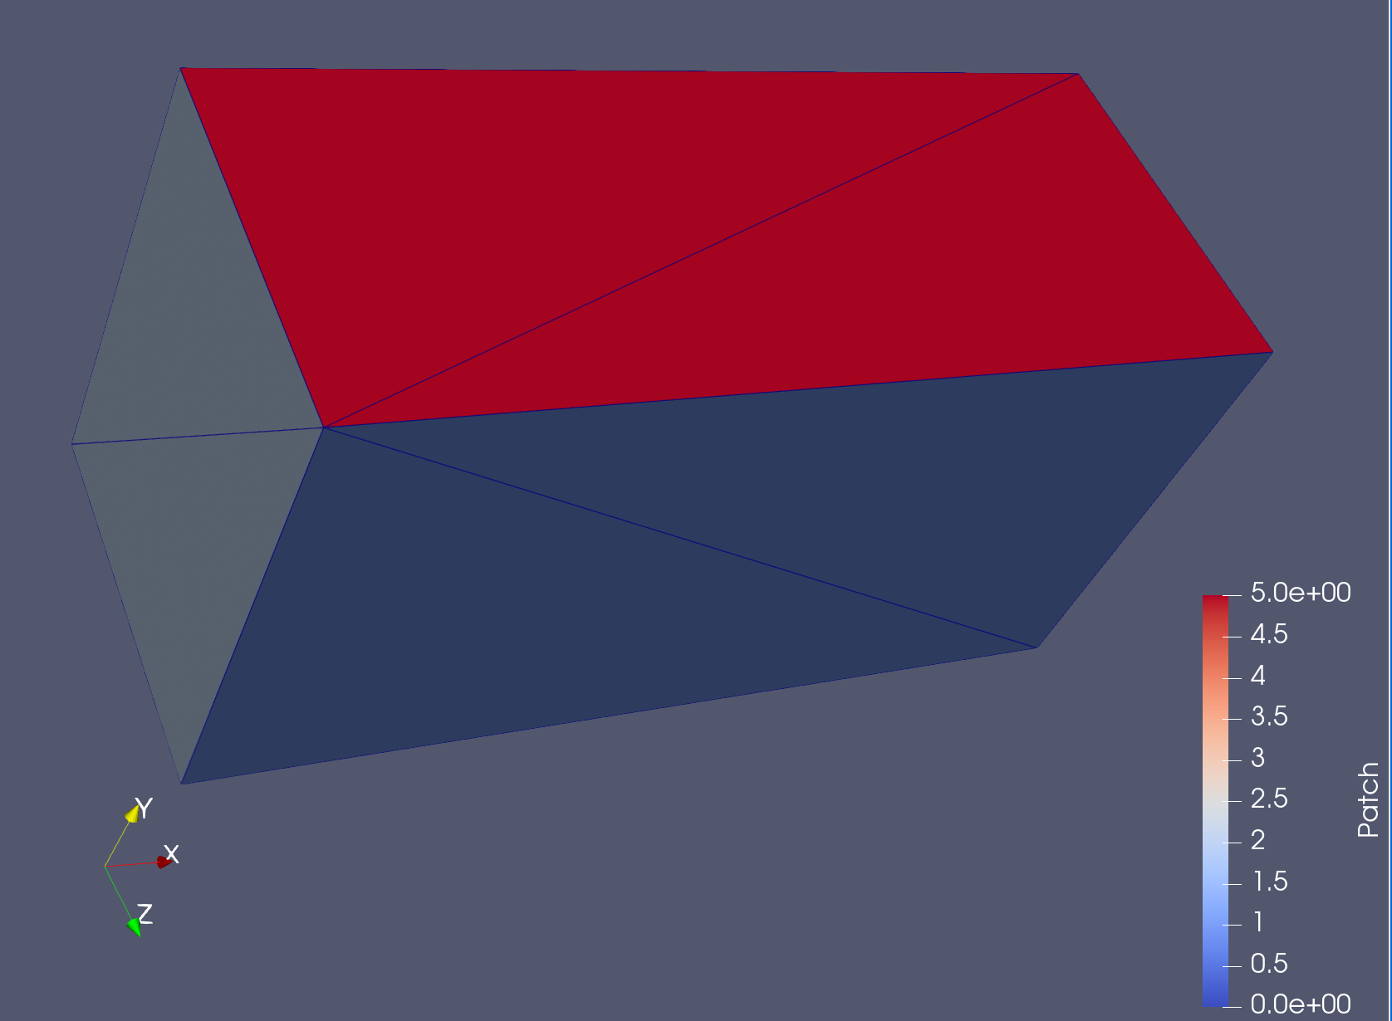
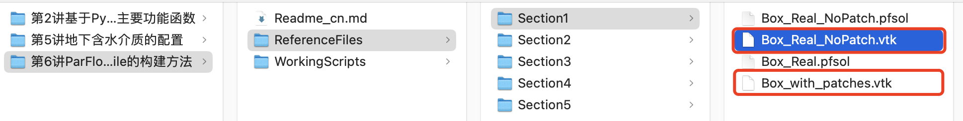
没有patch
有patch
Paraview

Slide 5
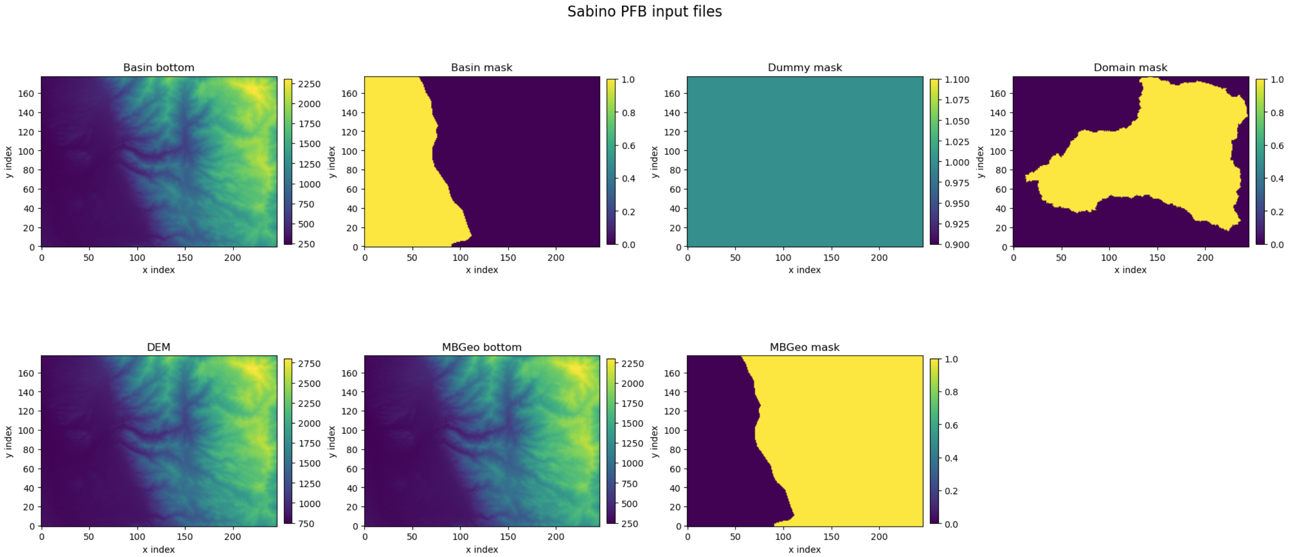
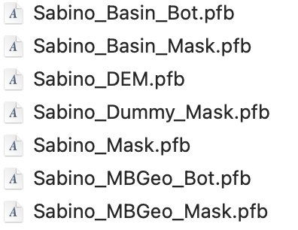
2. 为 Sabino Canyon 计算域构建实体
Sabino_Basin_Bot.pfb
Sabino_Basin_Mask.pfb
Sabino_Dummy_Mask.pfb
Sabino_Mask.pfb
Sabino_DEM.pfb
Sabino_MBGeo_Mask.pfb
Sabino_MBGeo_Bot.pfb
../ReferenceFiles/Section5

Slide 6
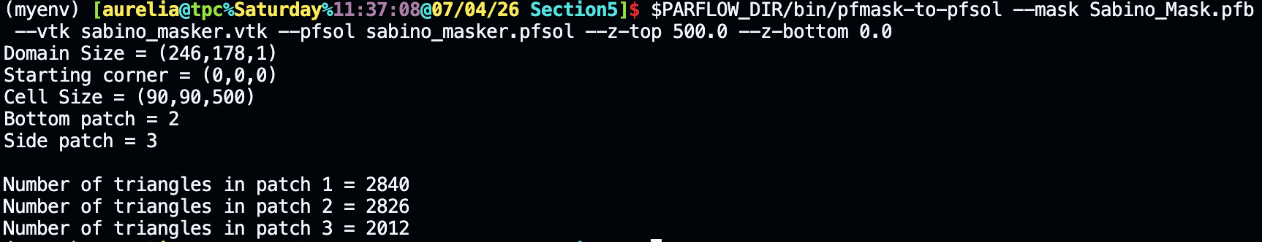
方案 1—为 TFG 使用简单掩膜
$PARFLOW_DIR/bin/pfmask-to-pfsol --mask Sabino_Mask.pfb --vtk sabino_masker.vtk --pfsol sabino_masker.pfsol --z-top 500.0 --z-bottom 0.0

Slide 7
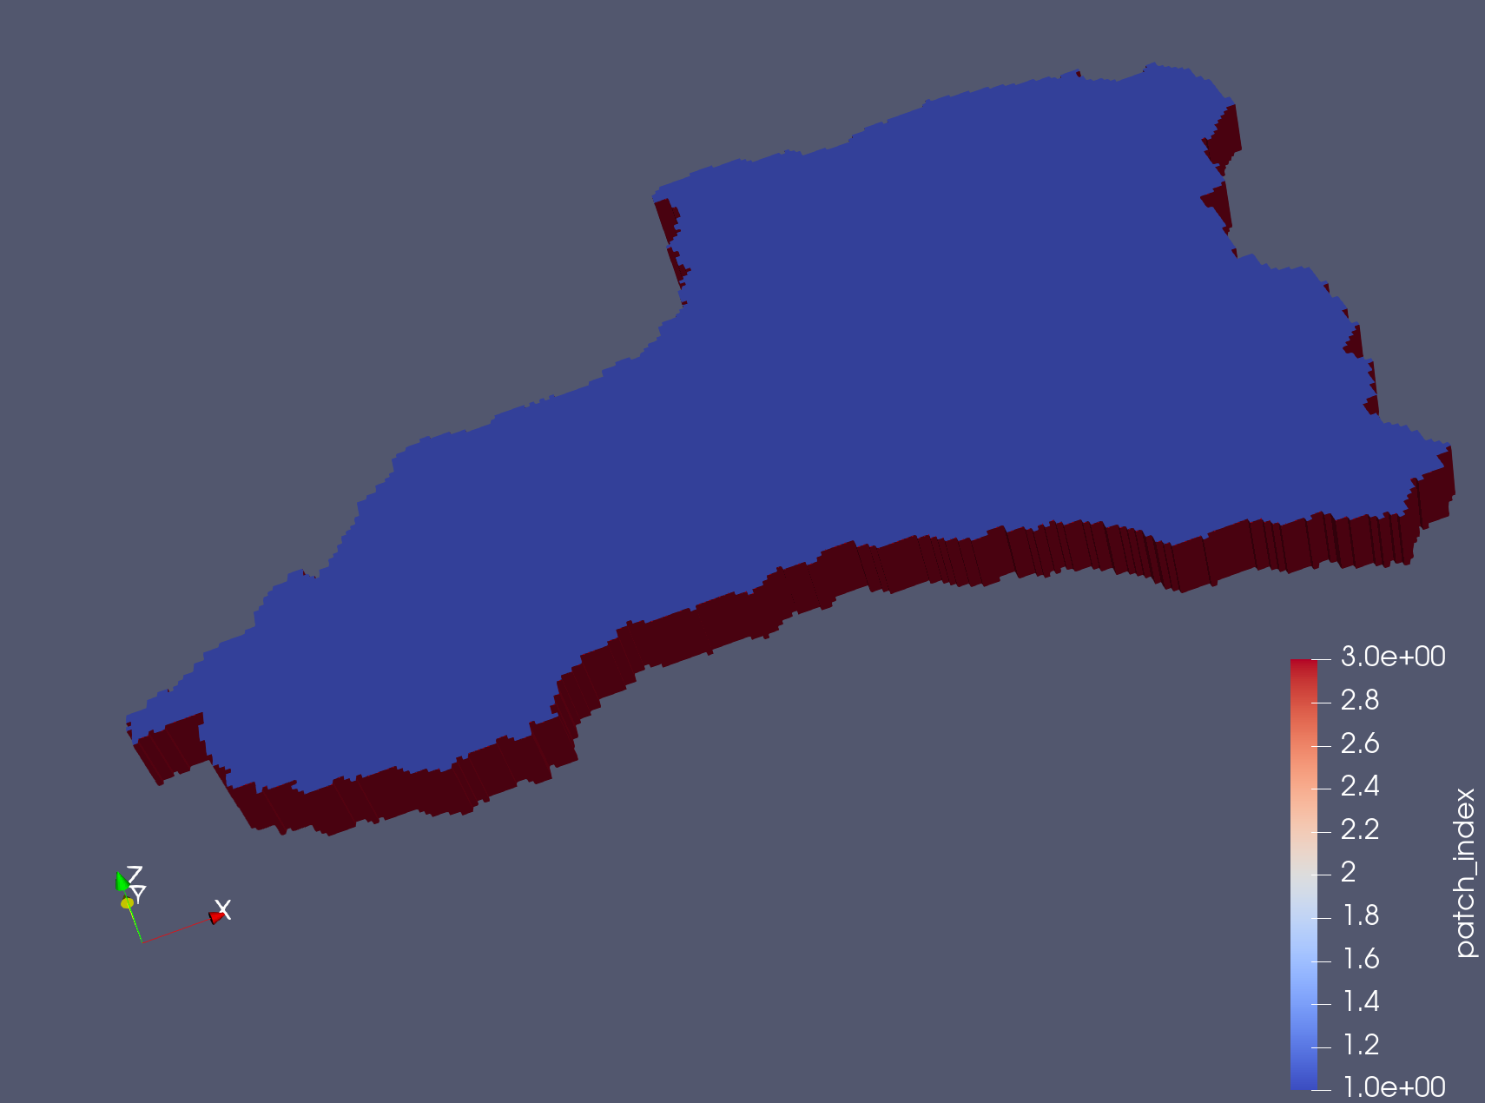
TFG

Slide 8
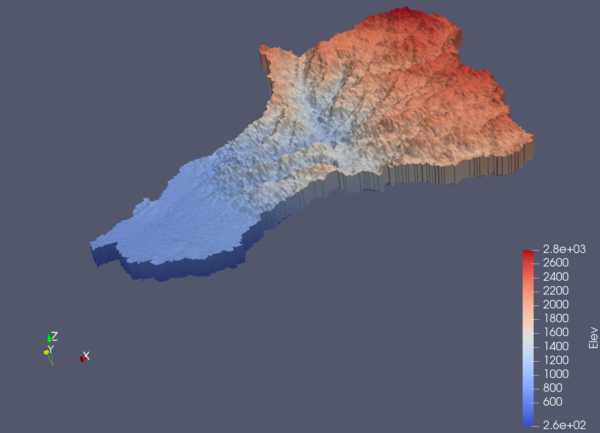
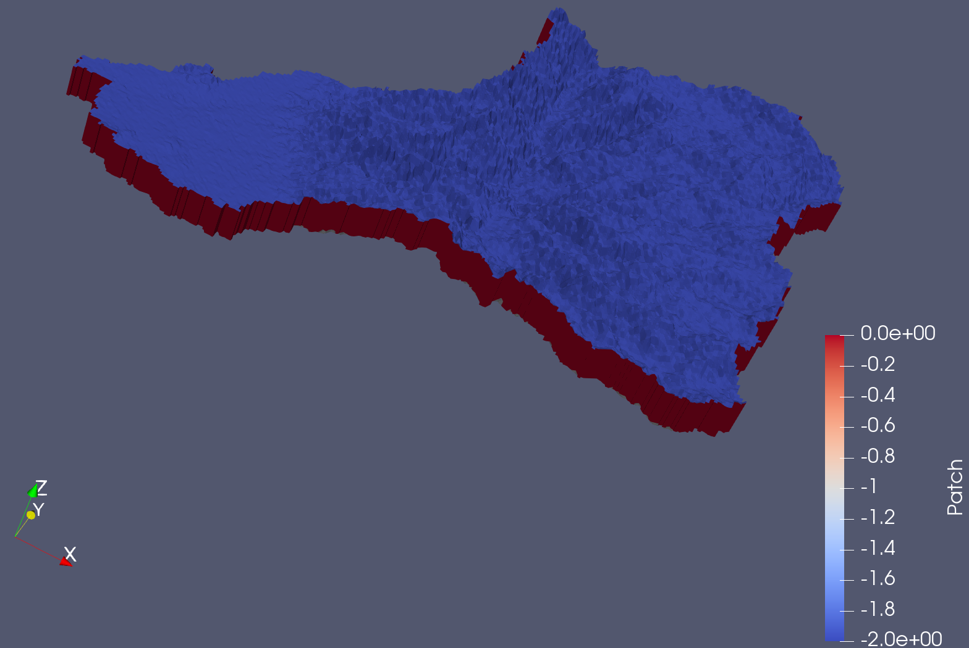
方案 2—步骤更多但更灵活的方法
OG
# ----- First we'll build the domain mask -----
set DEM [pfload -pfb "Sabino_DEM.pfb"]
set Mask [pfload -pfb "Sabino_Mask.pfb"]
set DMsk [pfload -pfb "Sabino_Dummy_Mask.pfb"]
set Bot [pfcellsumconst $DEM -500 $DMsk]
pfpatchysolid -top $DEM -bot $Bot -pfsol "sabino_mask_og.pfsol" -msk $Mask -vtk "sabino_mask_og.vtk"
OG

Slide 9
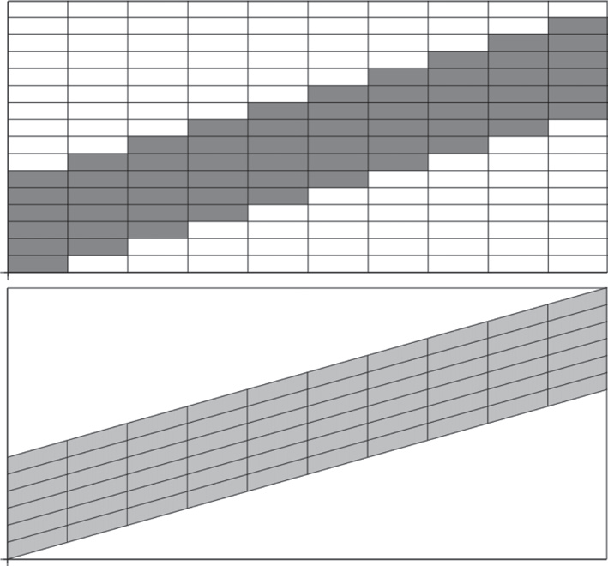
OG
TFG
Maxwell, AWR, 2013

Slide 10
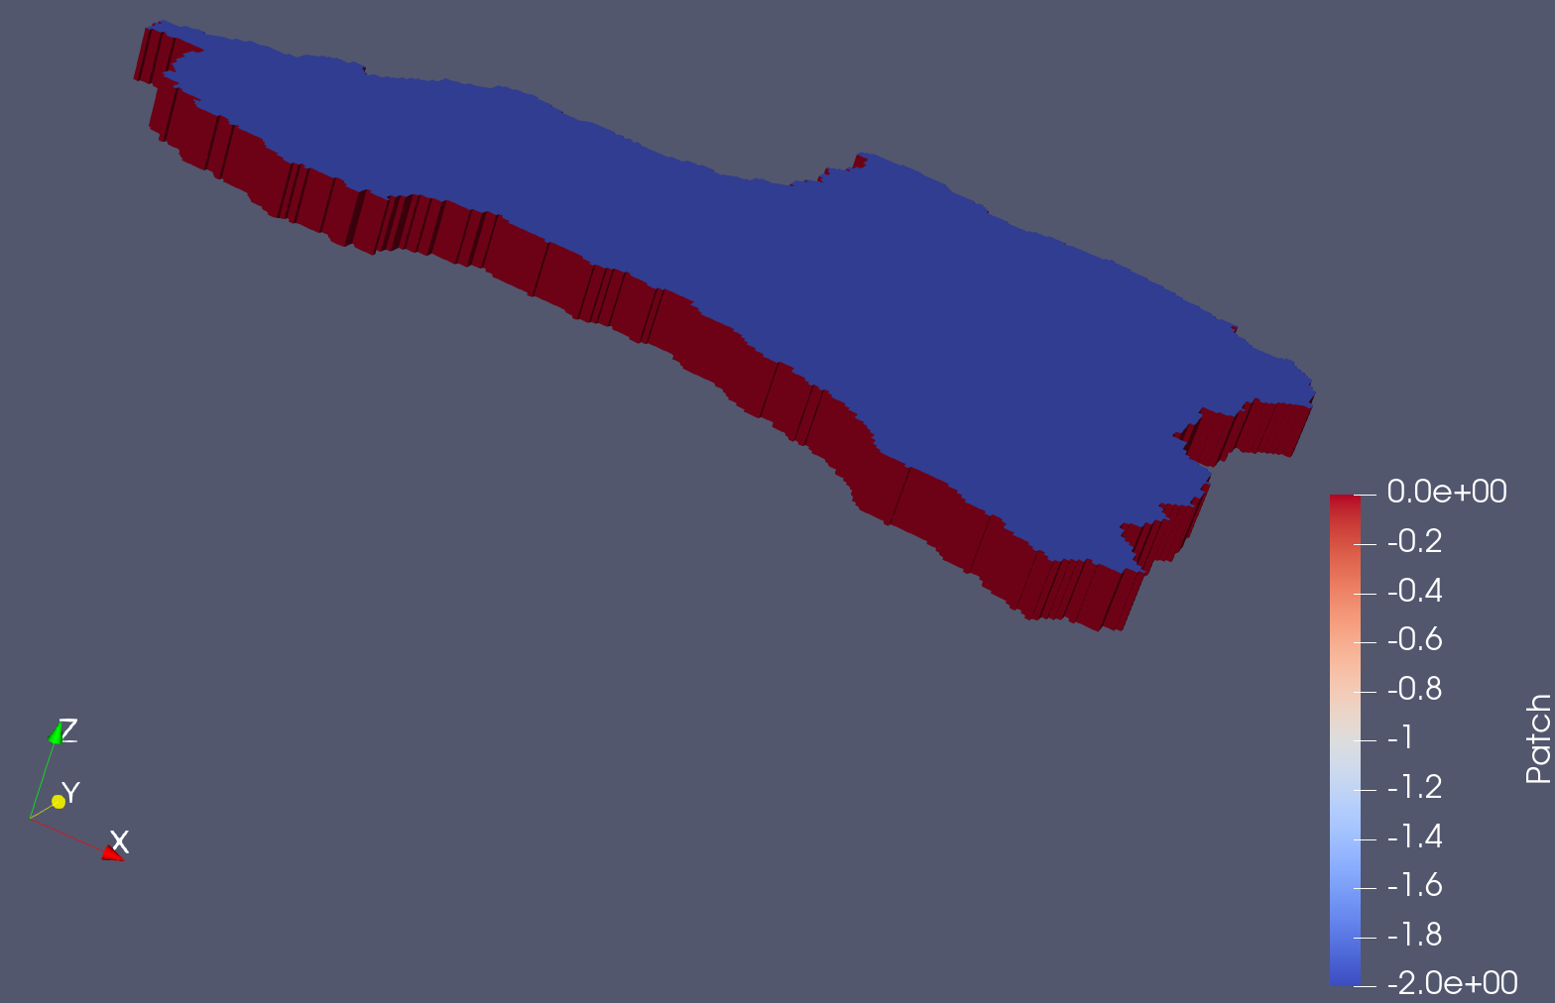
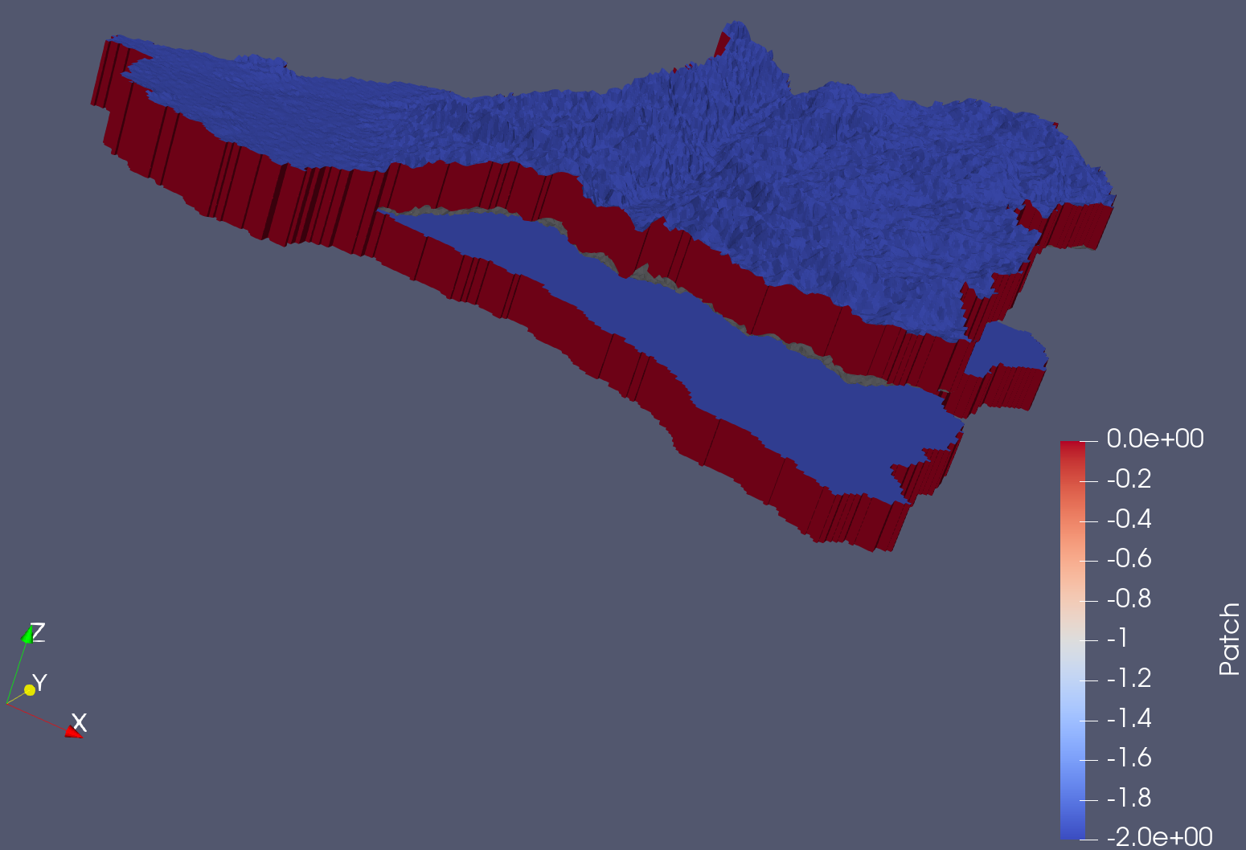
TFG
# Now transform it to be a TFG solid
set Top [pfcelldiff $DEM $DEM $DMsk]
set Bot [pfcelldiff $Bot $DEM $DMsk]
set Top [pfcellsumconst $Top 500 $DMsk]
set Bot [pfcellsumconst $Bot 500 $DMsk]
pfpatchysolid -top $Top -bot $Bot -pfsol "sabino_mask_tfg.pfsol" -msk $Mask -vtk "sabino_mask_tfg.vtk"
OG
TFG

Slide 11
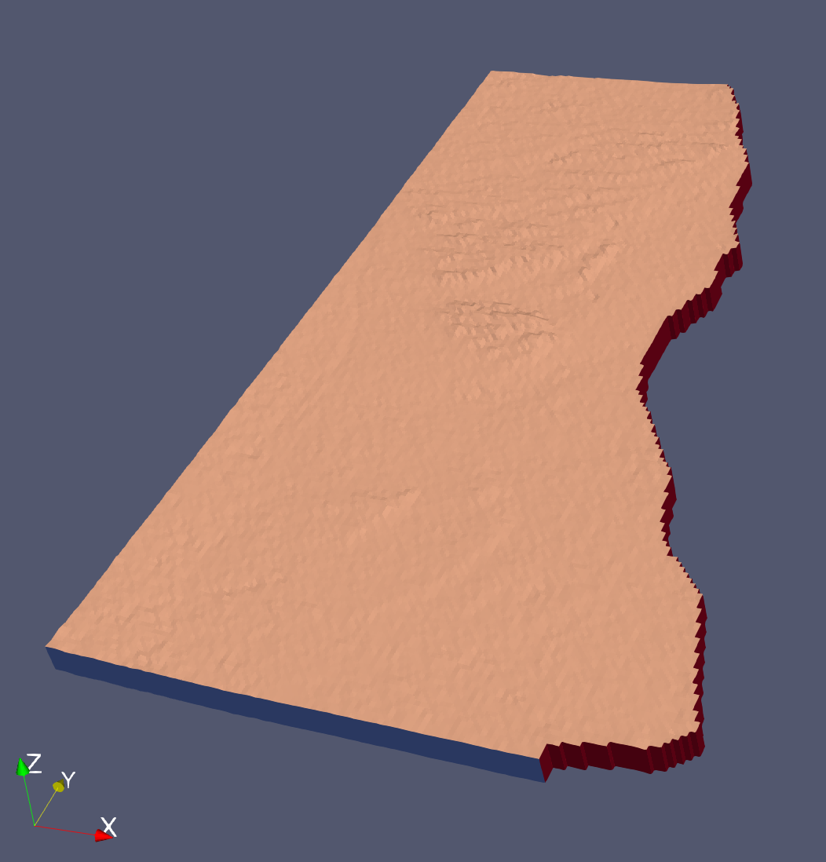
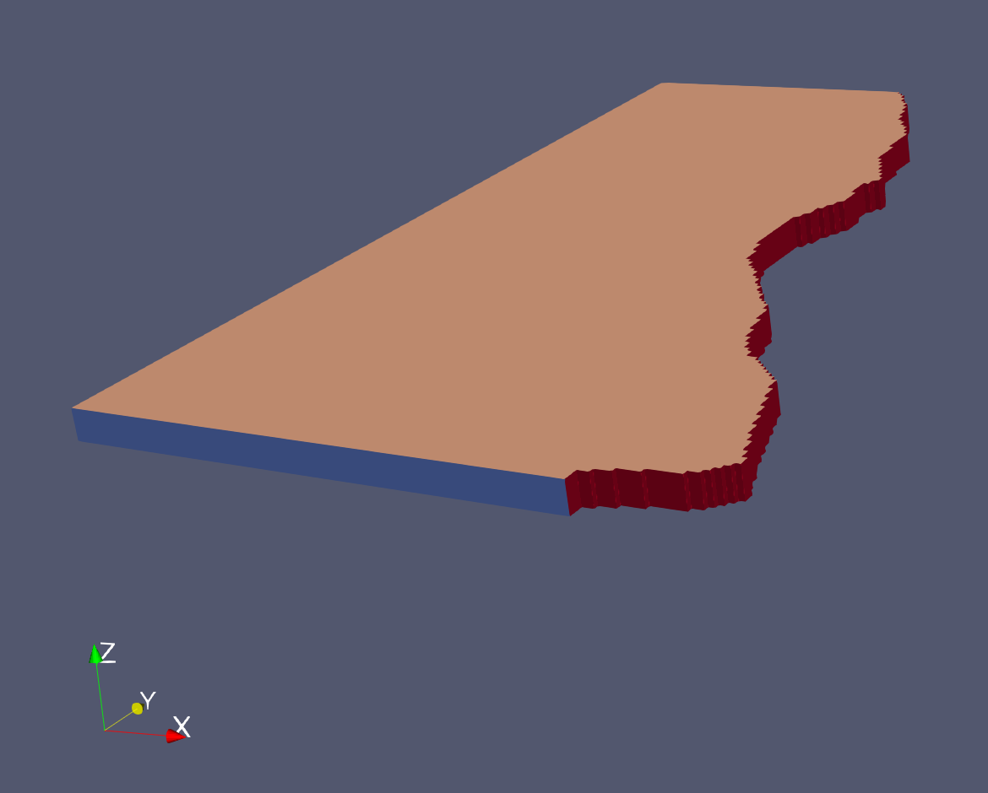
OG
# ----- Now we'll build the Basin fill region -----
set Msk [pfload -pfb "Sabino_Basin_Mask.pfb"]
set Bot [pfload -pfb "Sabino_Basin_Bot.pfb"]
pfpatchysolid -top $DEM -bot $Bot -pfsol "basin_OG.pfsol" -msk $Msk -vtk "basin_OG.vtk"
set TFGtop [pfcelldiff $DEM $DEM $DMsk]
set TFGbot [pfcelldiff $Bot $DEM $DMsk]
set TFGtop [pfcellsumconst $TFGtop 500 $DMsk]
set TFGbot [pfcellsumconst $TFGbot 500 $DMsk]
pfpatchysolid -top $TFGtop -bot $TFGbot -pfsol "basin_TFG.pfsol" -msk $Msk -vtk "basin_TFG.vtk"
TFG

Slide 12
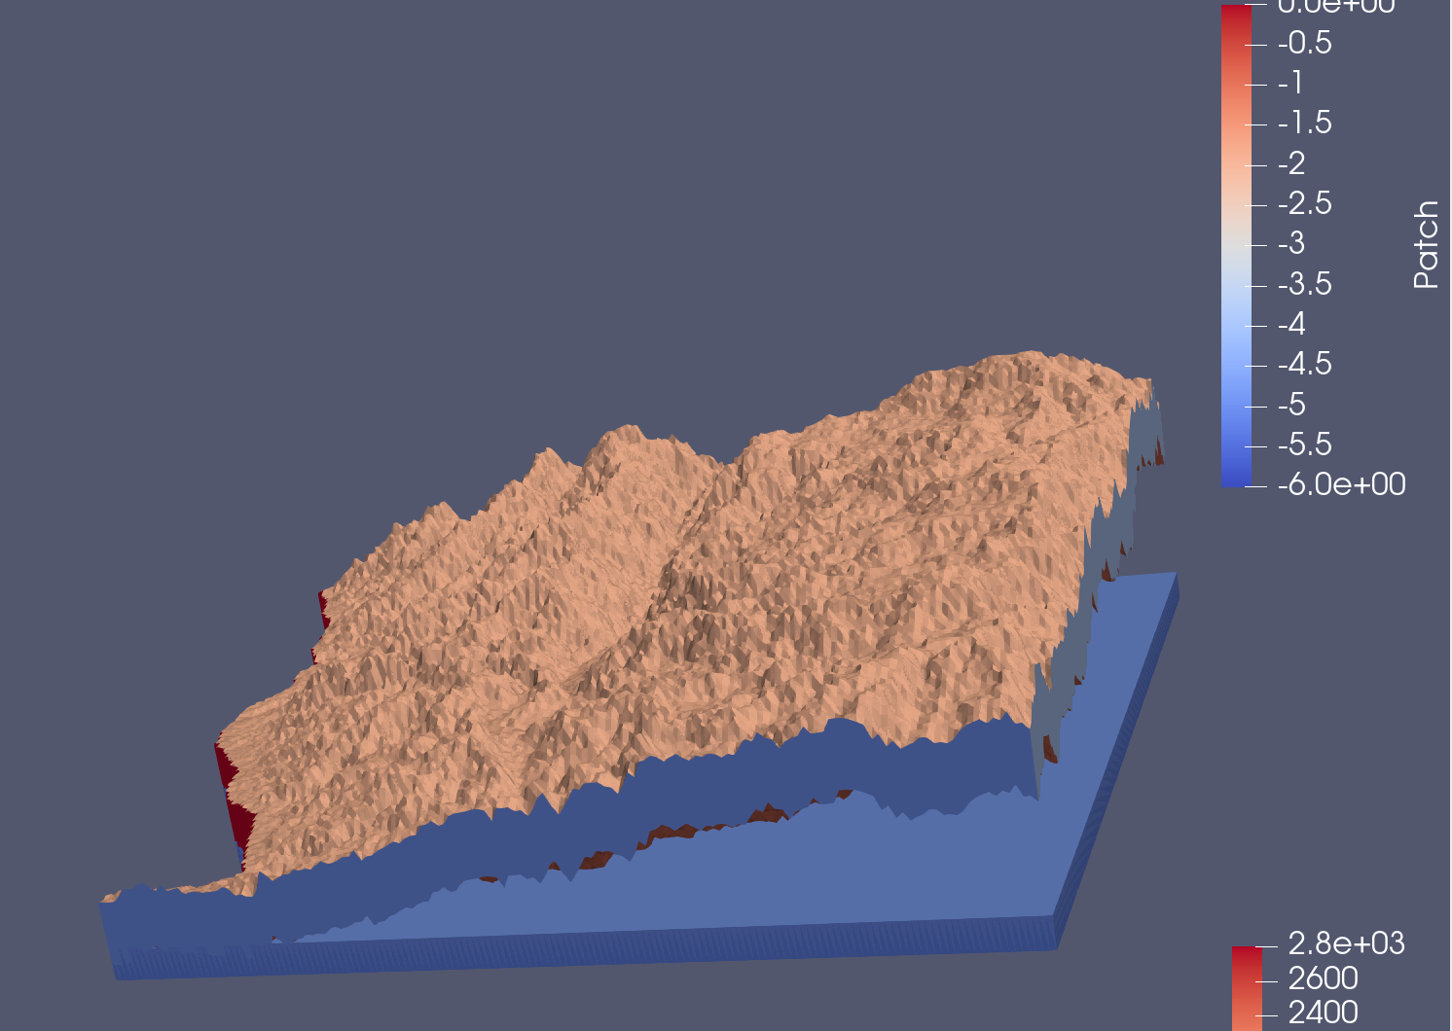
# ----- And now the mountain block region -----
set Msk [pfload -pfb "Sabino_MBGeo_Mask.pfb"]
set Bot [pfload -pfb "Sabino_MBGeo_Bot.pfb"]
pfpatchysolid -top $DEM -bot $Bot -pfsol "mbgeo_OG.pfsol" -msk $Msk -vtk "mbgeo_OG.vtk"
set TFGtop [pfcelldiff $DEM $DEM $DMsk]
set TFGbot [pfcelldiff $Bot $DEM $DMsk]
set TFGtop [pfcellsumconst $TFGtop 500 $DMsk]
set TFGbot [pfcellsumconst $TFGbot 750 $DMsk]
pfpatchysolid -top $TFGtop -bot $TFGbot -pfsol "mbgeo_TFG.pfsol" -msk $Msk -vtk "mbgeo_TFG.vtk"
OG
TFG

Slide 13
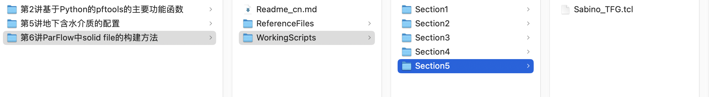
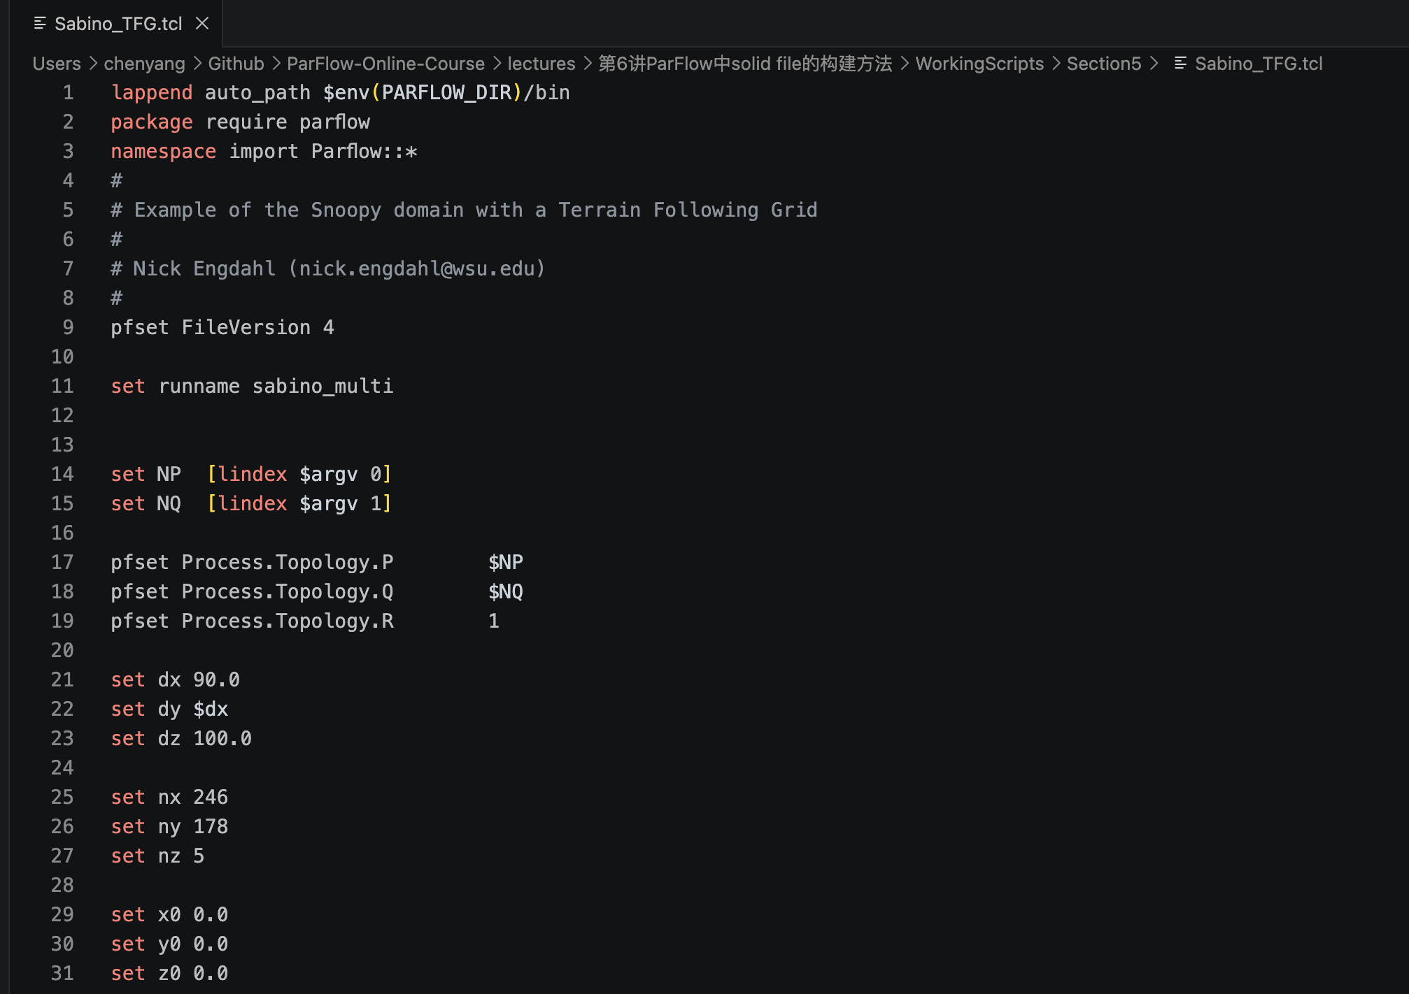
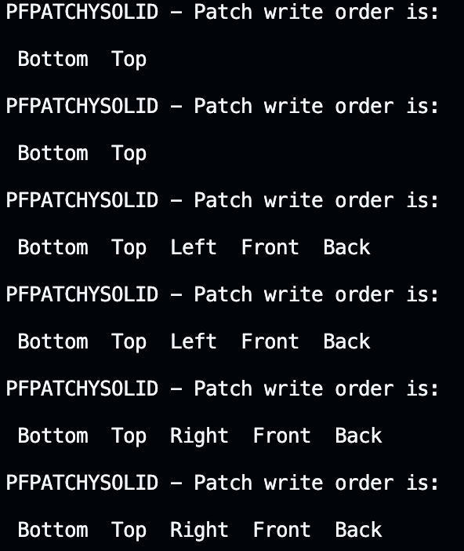
pfmask-to-pfsol 可以在命令行运行
pfpatchysolid 需要在tcl文件中调用
pfpatchysolid 生成的6个pfsol的patch信息

